Slide 1
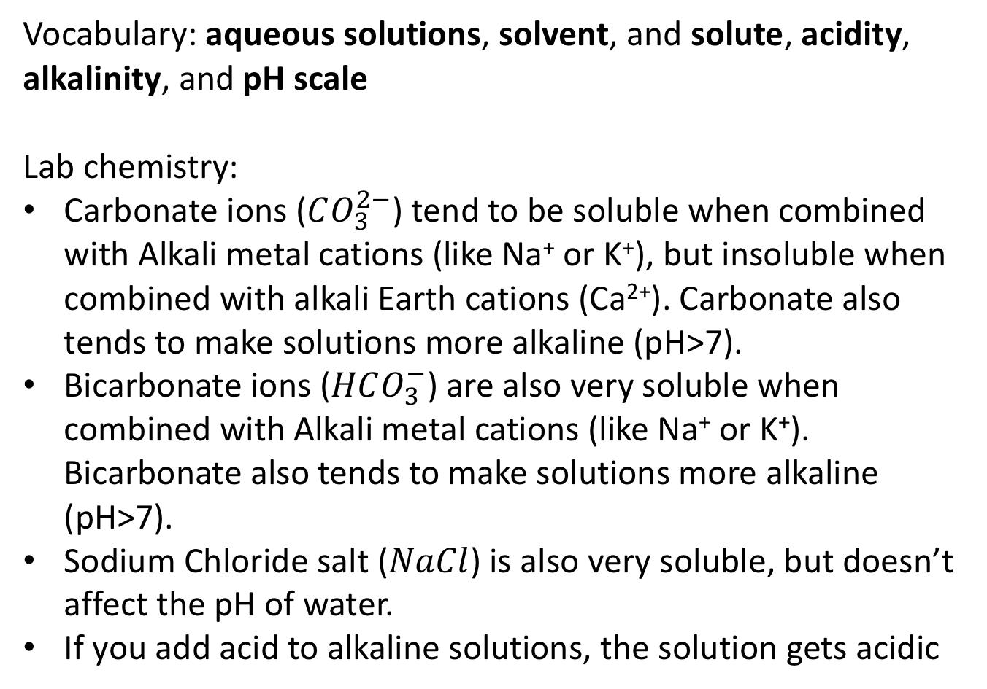
Take-home lessons from lab …
Vocabulary: aqueous solutions, solvent, and solute, acidity, alkalinity, and pH scale
Lab chemistry:
Carbonate ions ($CO_{3}^{2−}$) tend to be soluble when combined with Alkali metal cations (like Na⁺ or K⁺), but insoluble when combined with alkali Earth cations (Ca²⁺). Carbonate also tends to make solutions more alkaline (pH>7).
Bicarbonate ions ($HCO_{3}^{−}$) are also very soluble when combined with Alkali metal cations (like Na⁺ or K⁺). Bicarbonate also tends to make solutions more alkaline (pH>7).
Sodium Chloride salt ($NaCl$) is also very soluble, but doesn’t affect the pH of water.
If you add acid to alkaline solutions, the solution gets acidic

Slide 2
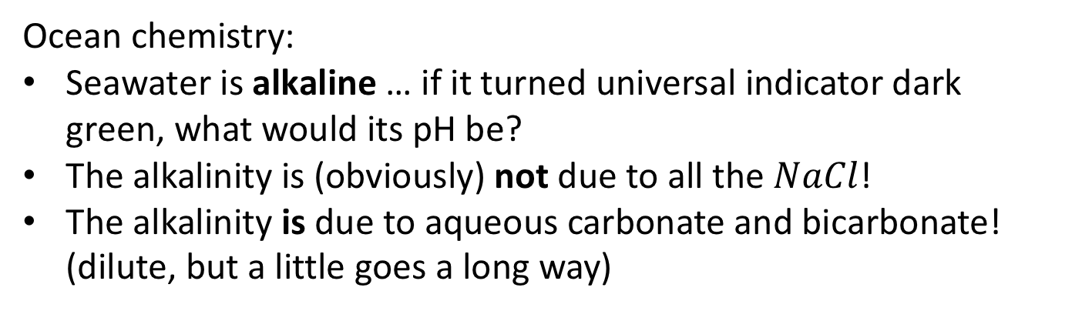
Take-home lessons from lab …
Ocean chemistry:
Seawater is alkaline … if it turned universal indicator dark green, what would its pH be?
The alkalinity is (obviously) not due to all the $NaCl$!
The alkalinity is due to aqueous carbonate and bicarbonate! (dilute, but a little goes a long way)

Slide 3
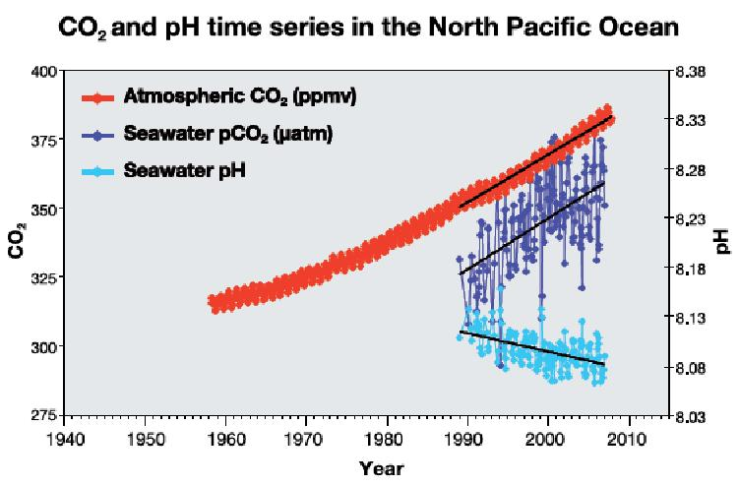
Take-home lessons from lab …

Slide 4
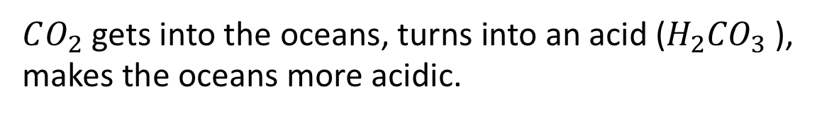
Take-home lessons from lab …
$CO_{2}$ gets into the oceans, turns into an acid (${H_{2}CO}_{3}$ ), makes the oceans more acidic.

Slide 5
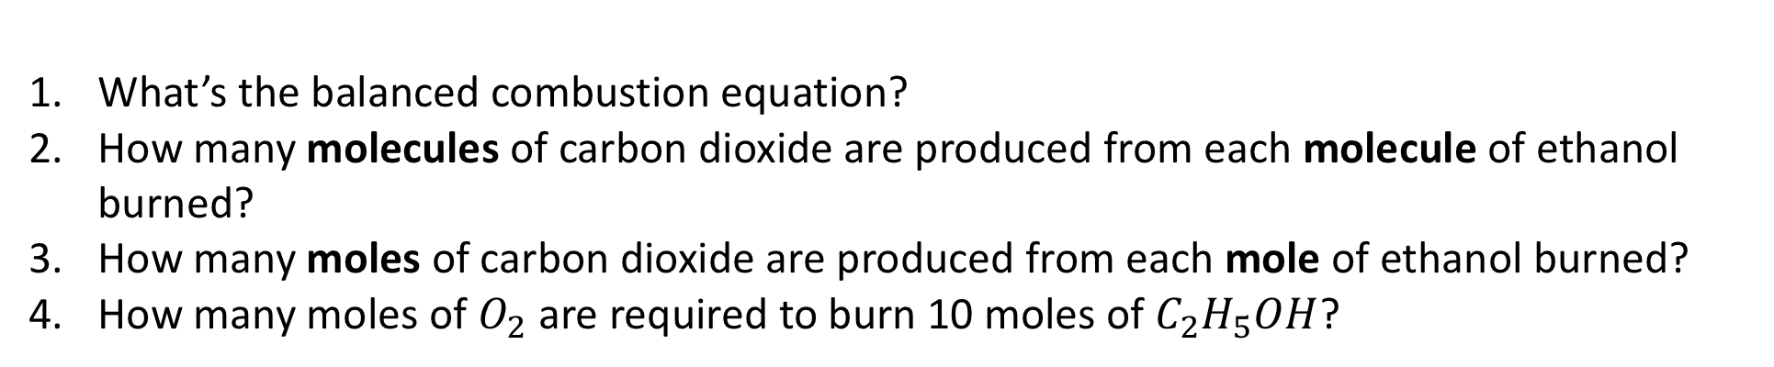
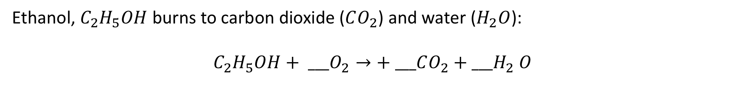
Counting molecules and moles in a chemical reaction
Ethanol, $C_{2}H_{5}OH$ burns to carbon dioxide ($CO_{2}$) and water ($H_{2}O$):
$C_{2}H_{5}OH+ ___O_{2}→+ ___CO_{2}{+ ___H}_{2}O$
What’s the balanced combustion equation?
How many molecules of carbon dioxide are produced from each molecule of ethanol burned?
How many moles of carbon dioxide are produced from each mole of ethanol burned?
How many moles of $O_{2}$ are required to burn 10 moles of $C_{2}H_{5}OH$?

Slide 6
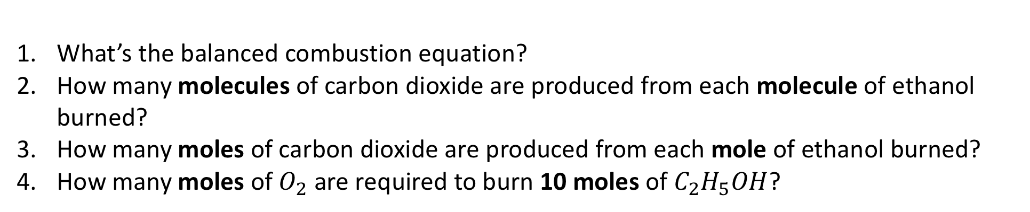
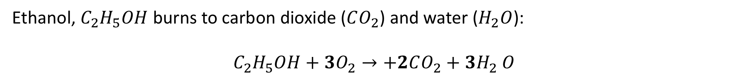
Counting molecules and moles in a chemical reaction
Ethanol, $C_{2}H_{5}OH$ burns to carbon dioxide ($CO_{2}$) and water ($H_{2}O$):
$C_{2}H_{5}OH+3O_{2}→+2CO_{2}{+ 3H}_{2}O$
What’s the balanced combustion equation?
How many molecules of carbon dioxide are produced from each molecule of ethanol burned?
How many moles of carbon dioxide are produced from each mole of ethanol burned?
How many moles of $O_{2}$ are required to burn 10 moles of $C_{2}H_{5}OH$?

Slide 7
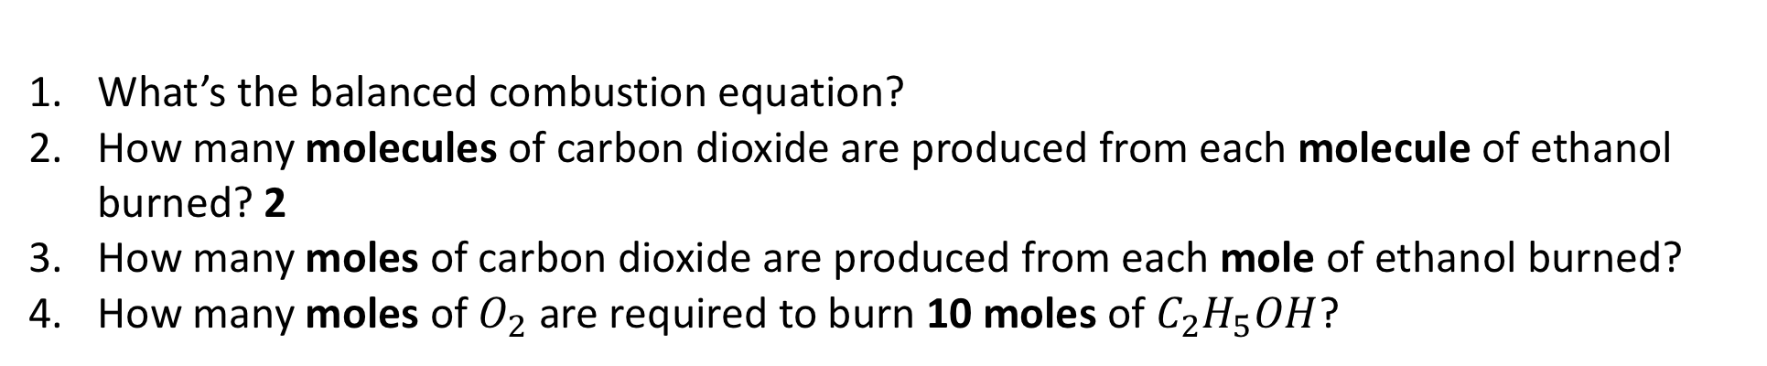
Counting molecules and moles in a chemical reaction
Ethanol, $C_{2}H_{5}OH$ burns to carbon dioxide ($CO_{2}$) and water ($H_{2}O$):
$C_{2}H_{5}OH+3O_{2}→+2CO_{2}{+ 3H}_{2}O$
What’s the balanced combustion equation?
How many molecules of carbon dioxide are produced from each molecule of ethanol burned? 2
How many moles of carbon dioxide are produced from each mole of ethanol burned?
How many moles of $O_{2}$ are required to burn 10 moles of $C_{2}H_{5}OH$?

Slide 8
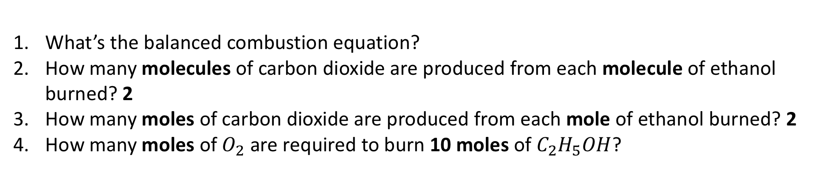
Counting molecules and moles in a chemical reaction
Ethanol, $C_{2}H_{5}OH$ burns to carbon dioxide ($CO_{2}$) and water ($H_{2}O$):
$C_{2}H_{5}OH+3O_{2}→+2CO_{2}{+ 3H}_{2}O$
What’s the balanced combustion equation?
How many molecules of carbon dioxide are produced from each molecule of ethanol burned? 2
How many moles of carbon dioxide are produced from each mole of ethanol burned? 2
How many moles of $O_{2}$ are required to burn 10 moles of $C_{2}H_{5}OH$?

Slide 9
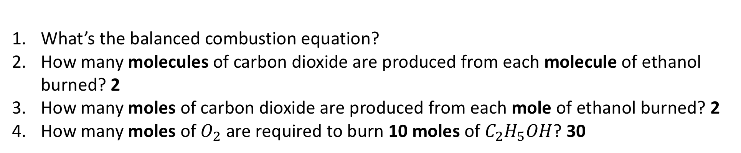
Counting molecules and moles in a chemical reaction
Ethanol, $C_{2}H_{5}OH$ burns to carbon dioxide ($CO_{2}$) and water ($H_{2}O$):
$C_{2}H_{5}OH+3O_{2}→+2CO_{2}{+ 3H}_{2}O$
What’s the balanced combustion equation?
How many molecules of carbon dioxide are produced from each molecule of ethanol burned? 2
How many moles of carbon dioxide are produced from each mole of ethanol burned? 2
How many moles of $O_{2}$ are required to burn 10 moles of $C_{2}H_{5}OH$? 30

